Slide 1
15th session.
The treasury plan
Notes:
We will deal with financial topics slowly because, finally, we have to use numbers for things.

Slide 2
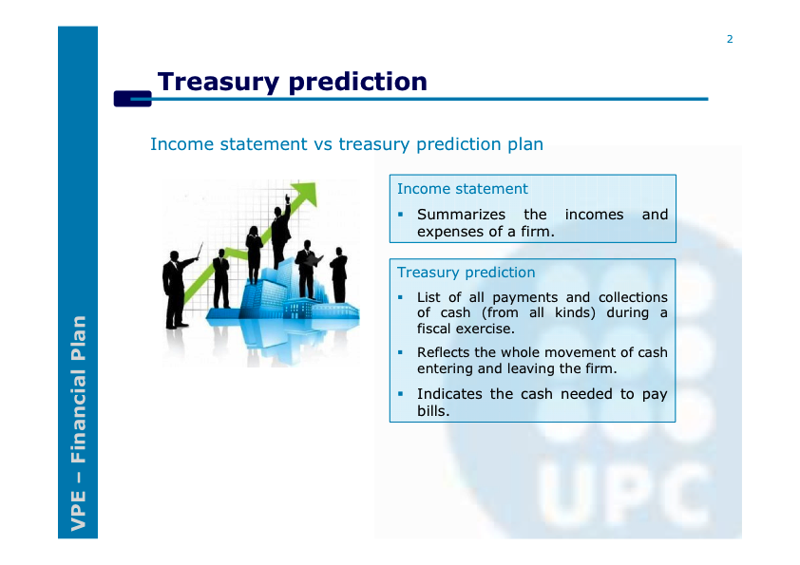

Slide 3
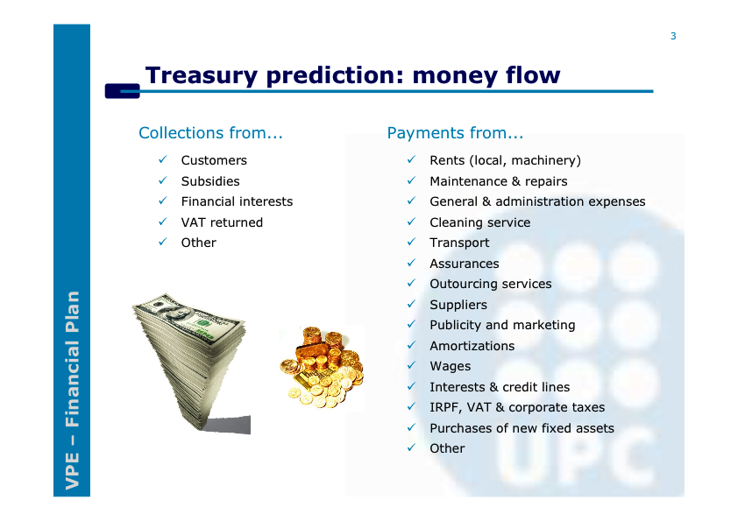

Slide 4
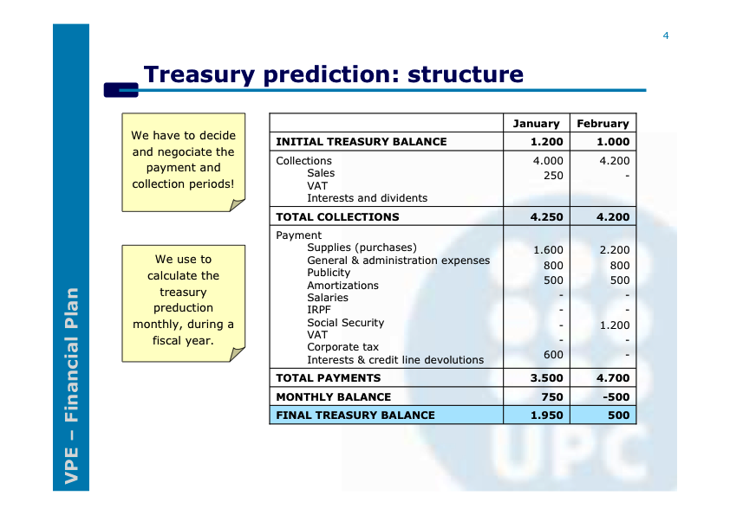

Slide 5
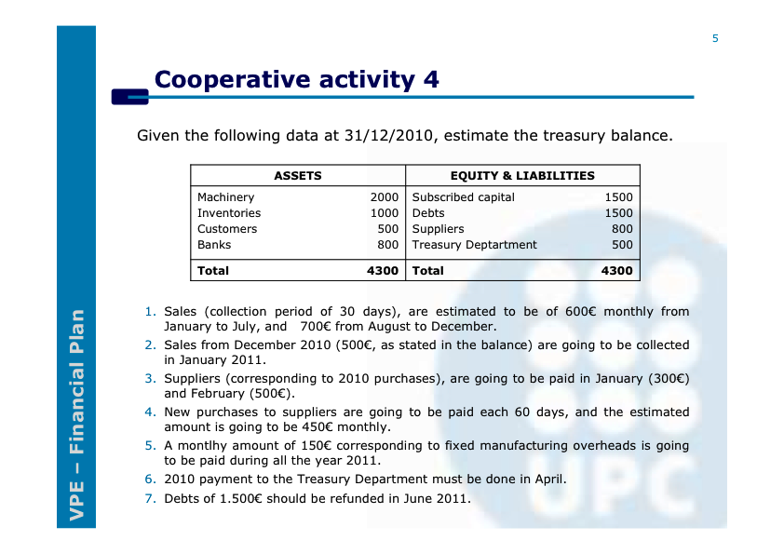

Slide 6
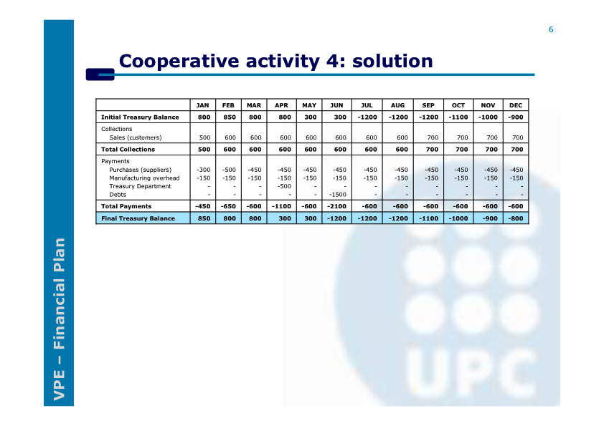

Slide 7
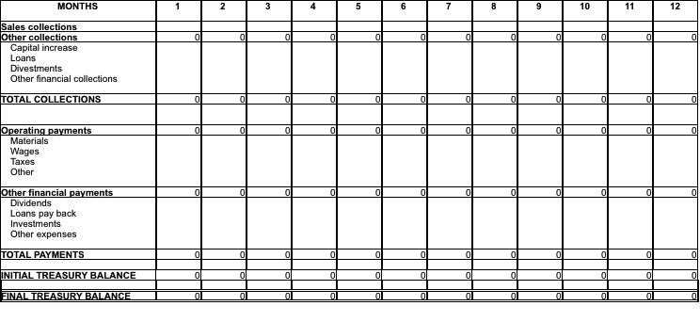
The treasury plan
Notes:
Slide explanation.

